Slide 1
Parsing Algorithms
Human Language from a Computational Perspective
May 30, 2018

Slide 2
Data structures so far
Lists [3, 16, 8, 0]
[he, gave, her, a, book]
Tables [the: 462, fish: 31, see: 9]

Slide 3
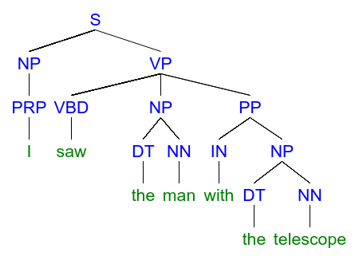
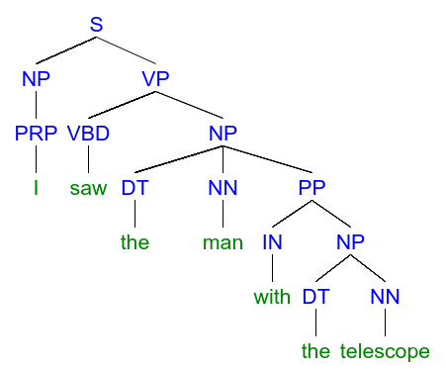

Reminder: phrase structure

Slide 4
Graphs
Undirected
Directed

Slide 5
Graphs
Node
Undirected
Directed

Slide 6
Graphs
Edge (arc)
Undirected
Directed

Slide 7
Trees
At most one incoming edge per node

Slide 8
Trees
Root

Slide 9
Trees
Leaf

Slide 10
Trees
Parent (head)

Slide 11
Trees
Child (dependent)

Slide 12
Phrase structure trees
Syntactic theory based on phrases.
Nodes have labels.
Tokens are leaves.

Slide 13
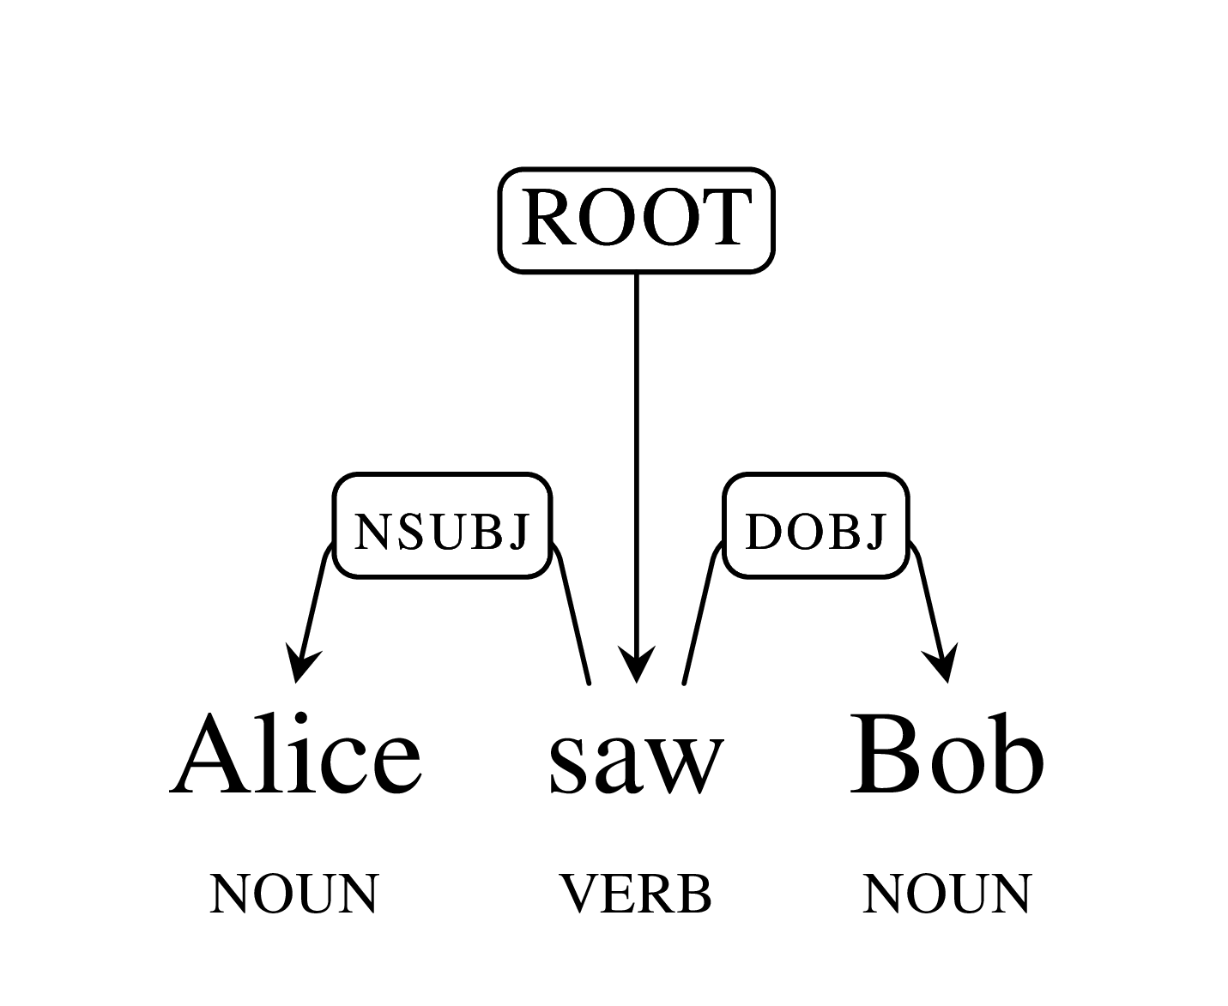
Dependency parsing
http://nlp.stanford.edu/software/dependencies_manual.pdf
Also syntax, but based on dependencies, not phrases.

Slide 14
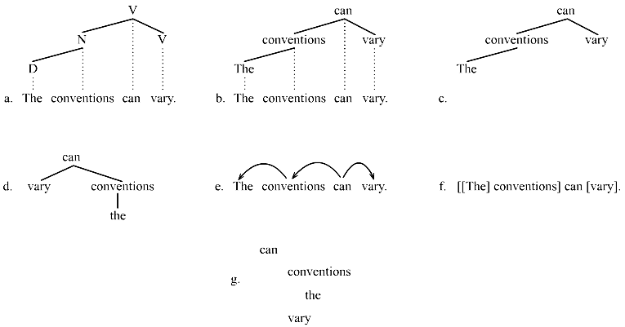
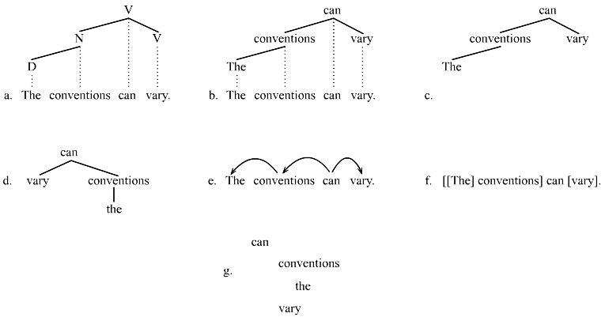
Dependency parsing
Also a tree, but edges are labeled
Tokens are all the nodes (not just leaves)

Slide 15
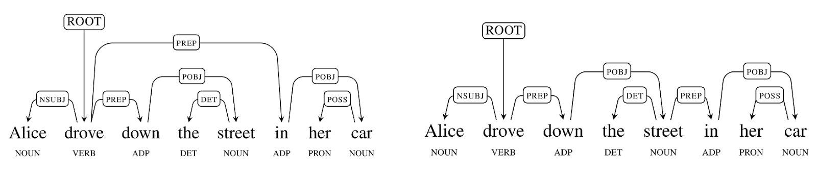
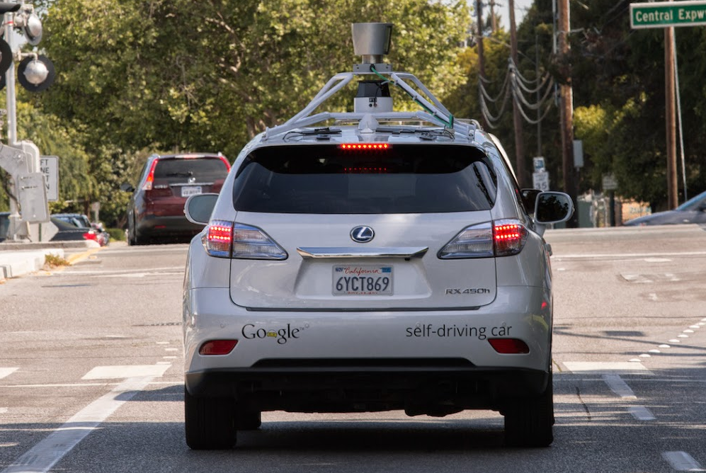
Syntactic ambiguity

Slide 16
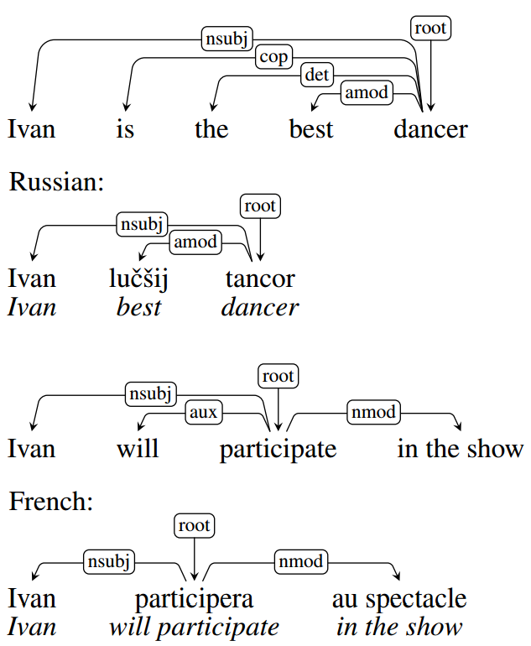
Universal dependencies
universaldependencies.org
http://universaldependencies.org/u/dep/index.html

Slide 17
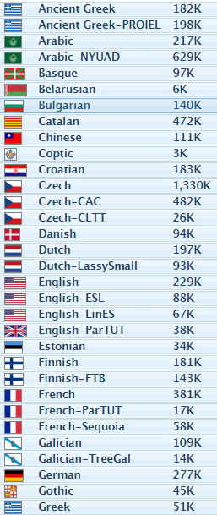
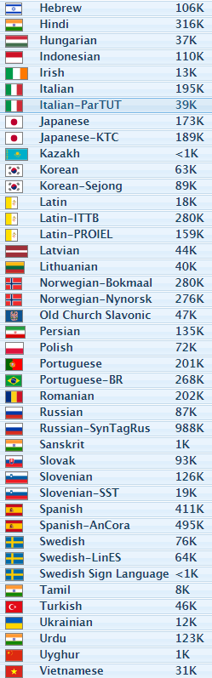
universaldependencies.org
Many languages parsed manually.

Slide 18
Resources: Treebanks
Many text corpora parsed by humans
Used for training automatic parsers

Slide 19
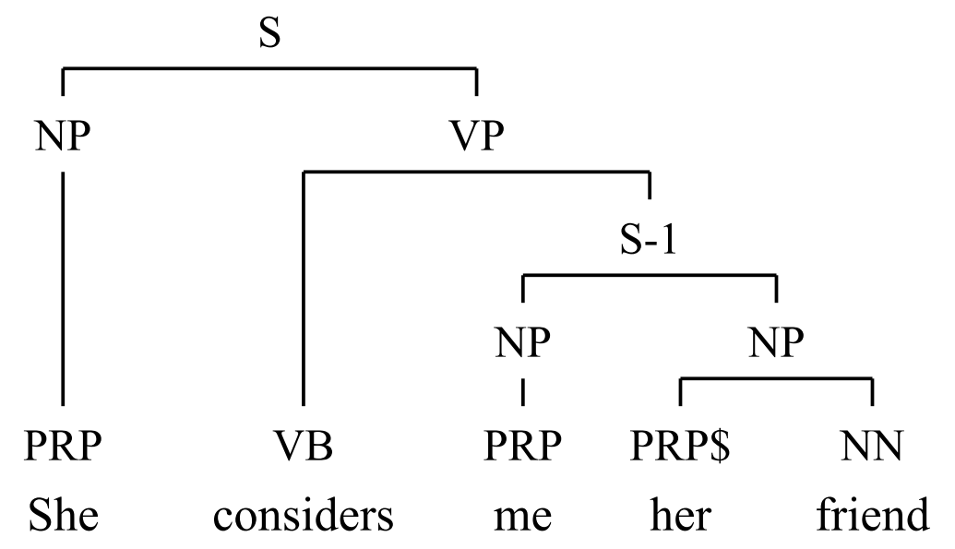
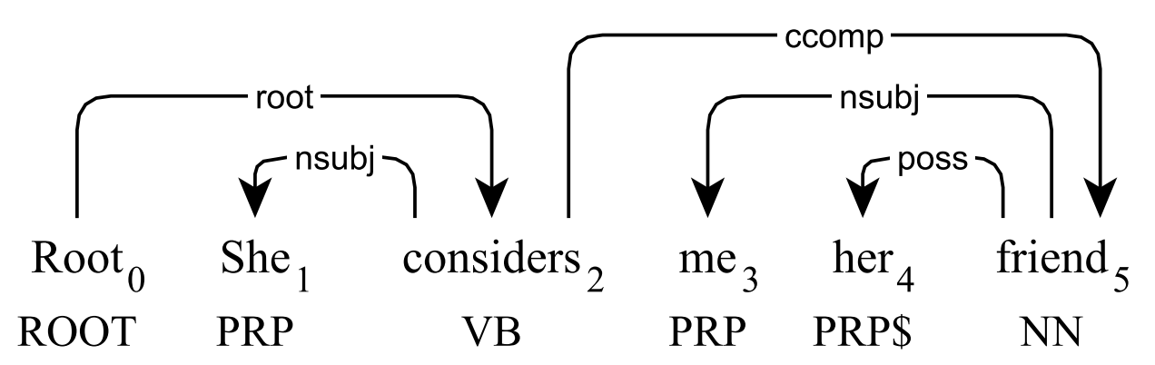
Treebank conversion
Trees can be automatically converted to save manual work

Slide 20
Dependency Parsing algorithm
Input: sentence (list of tokens)
Output: dependency tree
or simply, for each word, what is its head
and arc label

Slide 21
Dependency Parsing algorithm
[alice, saw, bob] →
[(2, nsubj), (0, root), (2, dobj)]
Use the index for each token.
The root node is denoted by 0.
alice
saw
bob
Notes:
Similar to tagging (e.g. POS) - can you suggest an algorithm?

Slide 22
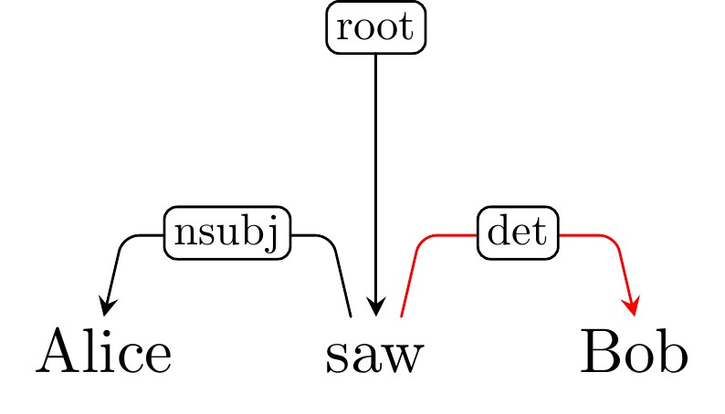
Evaluation
We have a corpus to train the algorithm,
And another labeled corpus to test it.
What if it returned an incorrect tree?

Slide 23
Evaluation
Labeled Attachment Score (LAS):
% of words with correct head and label
Unlabeled Attachment Score (UAS):
% of words with correct head
Always 0 ≤ LAS ≤ UAS ≤ 100%

Slide 24
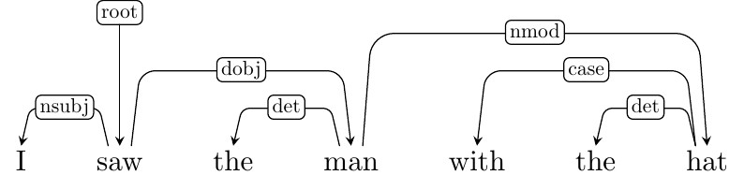
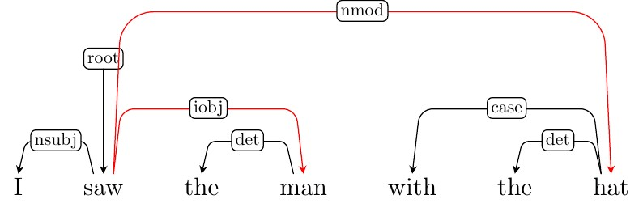
Evaluation example
Correct tree:
LAS = ⁵/₇ ≅ 71%
UAS = ⁶/₇ ≅ 86%
Evaluated tree:
“hat” has an incorrect head
“man” has a correct head but incorrect label

Slide 25
Parser scores (English)
googleresearch.blogspot.co.il/2016/05/announcing-syntaxnet-worlds-most.html
Parser | UAS (%) | LAS (%)
MaltParser | 90.93 | 88.95
MSTParser | 92.17 | 89.86
ZPar | 92.93 | 91.28
TurboParser | 93.80 | 92.00
Parsey McParseface | 94.41 | 92.55

Slide 26
Transition-based parsing
Incremental parsing algorithms:
Build the tree one arc at a time.
Apply transitions until the full tree is built.

Slide 27
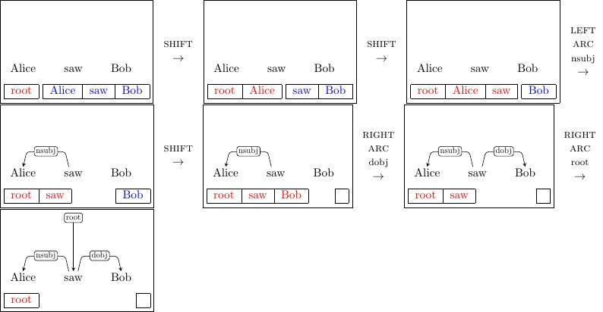
Transition-based parsing
Using two lists: stack and buffer.
The stack keeps nodes being processed.
The input tokens are taken from the buffer.
...
...
Stack
Buffer
Stack
Buffer
Stack
Buffer

Slide 28
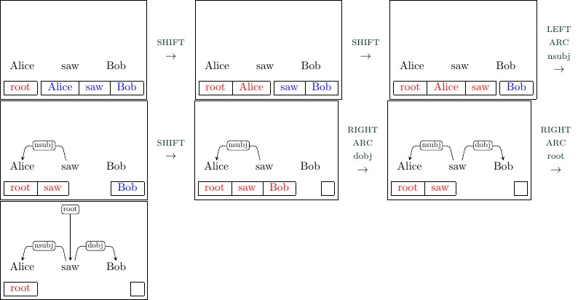
Transition-based parsing
Possible transitions at each time step:
shift left-arc right-arc
(Move node from buffer to stack)
(Create left/right arc between two rightmost stack nodes, and delete child)
Need to say the label to create (e.g. dobj)

Slide 29
Transition-based parsing

Slide 30
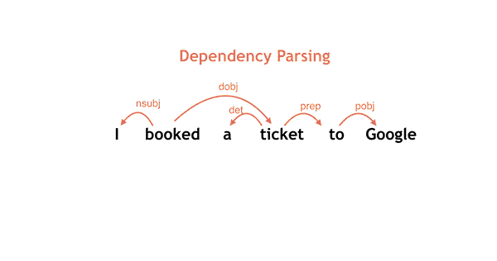
Transition-based parsing

Slide 31
Transition-based parsing
Where is the learning in the algorithm?
When we have a labeled tree, we know which transitions we need to get to it.
The parser learns how to make these decisions so it can parse new sentences correctly.

Slide 32
Transition-based parsing
If we see the state on the left here, we need to know to apply right-arc_{dobj}

Slide 33
Machine learning
Learning: getting better in a task based on experience.
Examples we have seen in this course:
wish I could | 20
wish I had | 10
Language modeling,
Part-of-speech tagging
I wish I _
sleep well
nn rb
the | dt | 1527
well | rb | 37
nn | nn | 312
nn | in | 690

Slide 34
Machine learning
Count-based learning would not work well for transition-based parsing

Slide 35
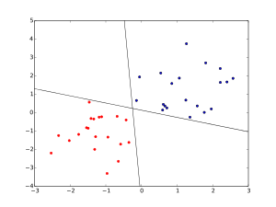
Machine learning
Learning algorithms used for parsing:
Perceptron
Neural networks
...

